Slide 1

Smart Dermatology Assistant using AI and Image Processing DSA0216-Computer Vision with OpenCV for Modern AI
Presented by:
B.Akshaya(192424336)
Ch.Sri Deepika(192424412)
P.Sunayana(192424303)
Under the guidance by:
Dr. Senthilvadivu S
Dr. T kumargurubaran

Slide 2


INTRODUCTION
Skin diseases affect millions and require timely diagnosis.
AI-based image analysis improves accuracy and speed of detection.
The system identifies disease type, severity, and risk level automatically.
Users receive personalized care and treatment recommendations instantly.

Slide 3


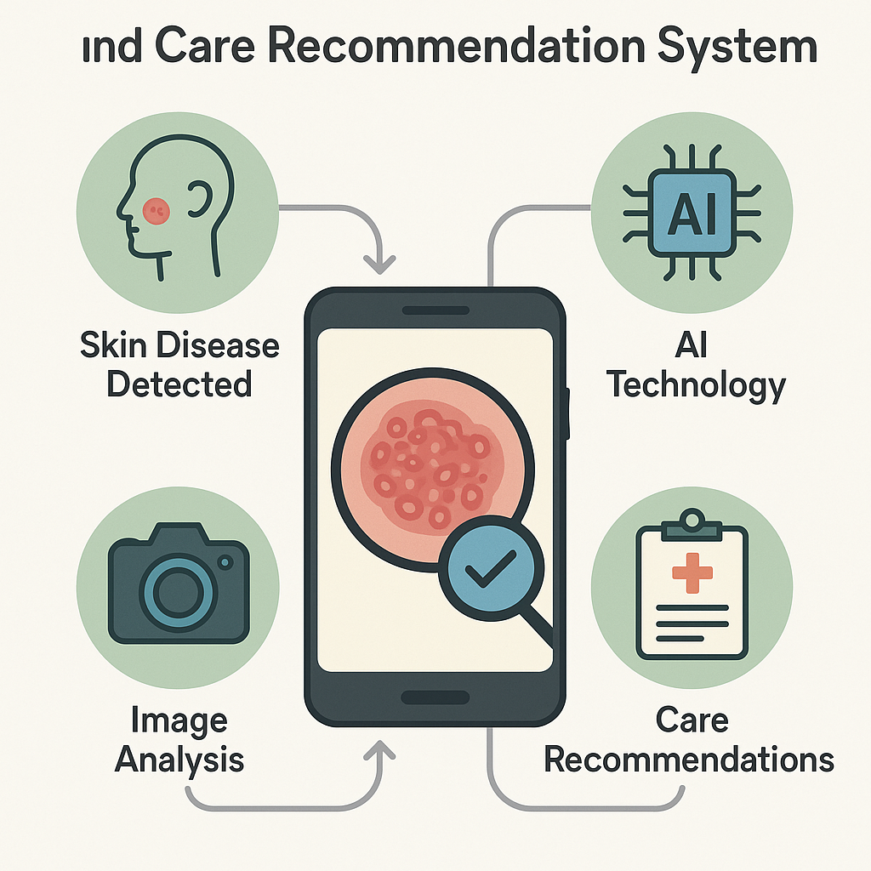
OBJECTIVES
To develop an AI-based system for automatic skin disease detection
To analyze skin images using image processing techniques
To accurately classify common skin diseases using CNN models
To provide basic care, treatment, and preventive recommendations
To assist in early diagnosis and support remote healthcare services

Slide 4

Existing system
Skin disease detection is done manually by dermatologists.
Diagnosis depends on doctor’s experience and visual inspection.
No automation or AI support to identify diseases.
Severity level is not measured accurately in many cases.
Manual process is time-consuming and may delay treatment.
Chances of human error increase when checking large numbers of patients.

Slide 5

Proposed system
Develop a smart AI-based application to detect skin diseases from images
Capture or upload skin images using a mobile phone or camera
Use image processing and CNN-based deep learning model to analyze the skin
Automatically classify the type of skin disease (e.g., acne, eczema, infection)
Provide basic care, treatment suggestions, and prevention tips to the user

Slide 6
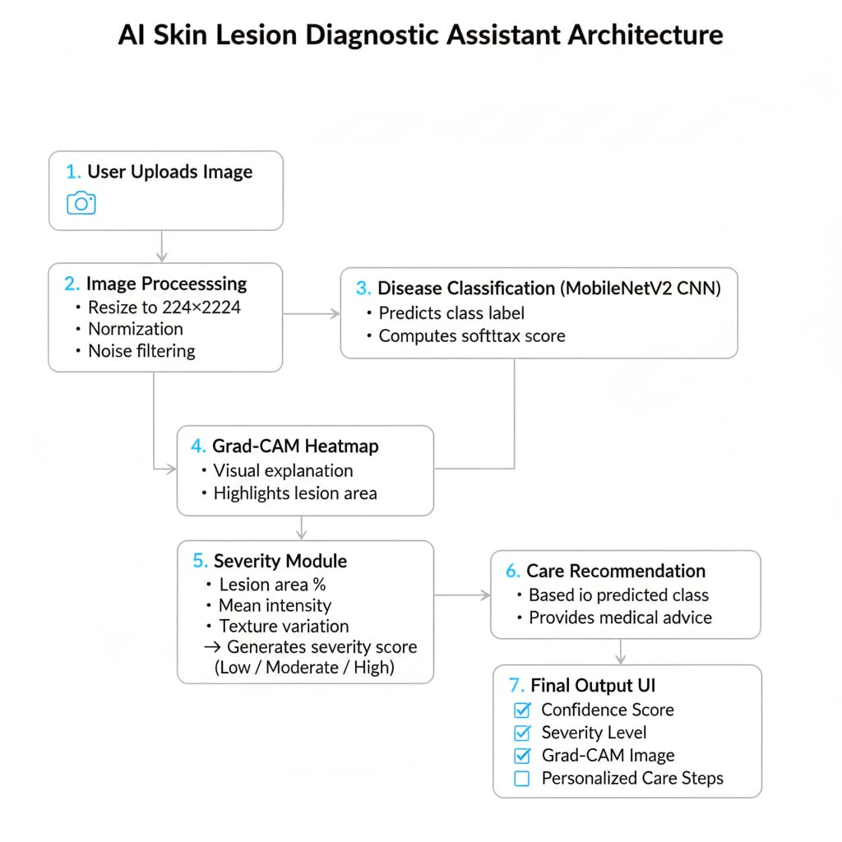
ARCHITECTUR DIAGRAM

Slide 7
LITERATURE SURVEY
Year | Author | Technique Used | Dataset | Outcome
2020 | Wu et al. | CNN-based skin disease classification | Clinical skin images | High accuracy in detecting common skin diseases
2021 | Srinivasu et al. | MobileNet (Deep Learning) | Kaggle skin dataset | Lightweight model suitable for mobile apps
2022 | Al-Masni et al. | CNN + Segmentation | ISIC dataset | Improved accuracy using lesion segmentation
2023 | Ahammed et al. | ML + Image Processing | ISIC dataset | Skin disease detection using hybrid approach
2024 | Marri et al. | AI Mobile App (CNN) | Real-world user images | Effective for early detection and awareness

Slide 8
Tools & Technologies Used
Python 3.12 – Core environment for integrating prediction, severity logic, and full system automation.
TensorFlow & Keras – Used for building, training, and loading the MobileNetV2 skin disease detection model.
OpenCV & PIL – Applied for image preprocessing, lesion masking, enhancement, and feature extraction.
Google Colab – Platforms used for dataset handling, model training, Grad-CAM analysis, and experimentation.
Visual Studio Code (VS Code) – Used to organize modules, structure the final project, and run the complete workflow locally.

Slide 9
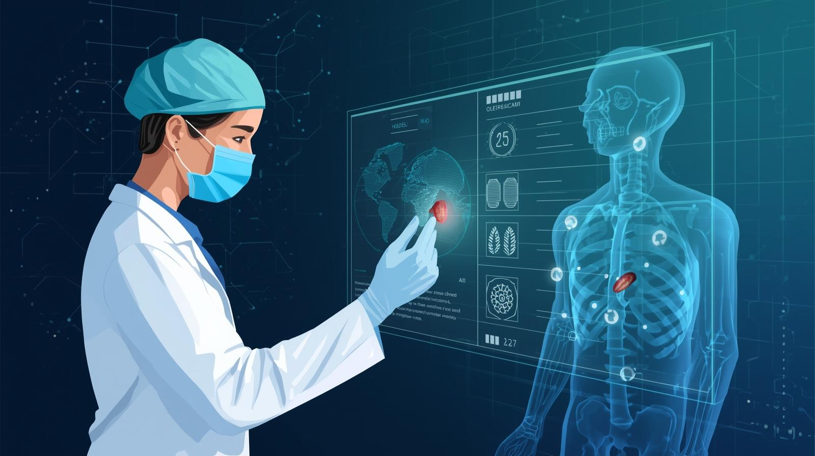
Module 1: Skin Disease Detection using AI & Image Processing
We collected different types of skin disease images for training the model.
The images were cleaned and resized using preprocessing techniques.
We used the MobileNetV2 deep learning model to detect skin diseases.
The model studies color, texture, and shape of the skin lesion.
It gives the disease name and prediction result for further analysis.

Slide 10
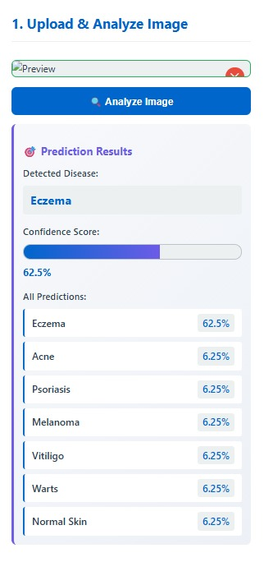
Module 1:OUTPUT

Slide 11
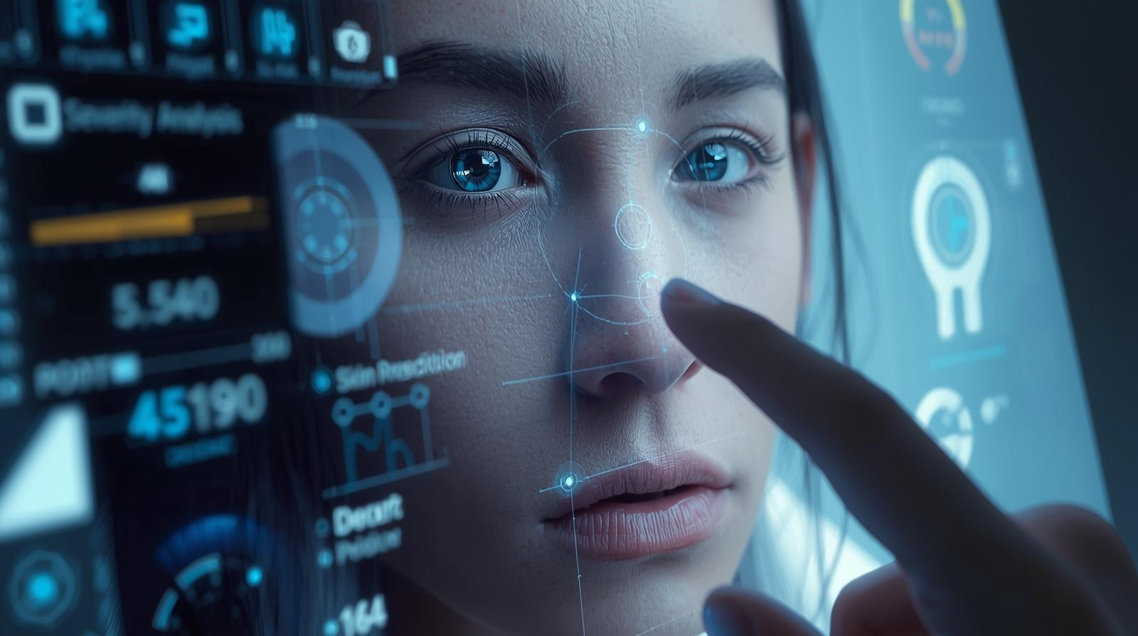
Module 2: Severity Analysis & Risk Level Prediction
Extracted detailed lesion features such as area coverage, texture variation, and color intensity.
Computed a severity score using a weighted feature evaluation system.
Classified each case into Mild, Moderate, or Severe categories.
Designed a structured severity report for every input image.
Enabled risk-aware decision making by linking severity to the recommendation module.

Slide 12
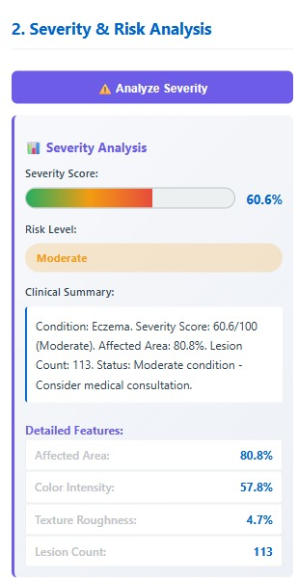
Module2:OUTPUT

Slide 13
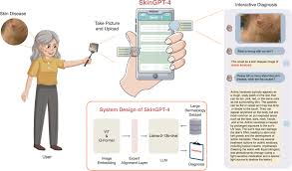
Module 3: Care Recommendation & Preventive Guidance System
Built a rule-based system to suggest care based on disease type.
Gave medically accurate home-care tips and safety precautions.
Suggests doctor consultation when needed.
Recommended dermatologist visits for moderate and severe cases.
Provided simple, clear guidance for patients to follow easily.

Slide 14
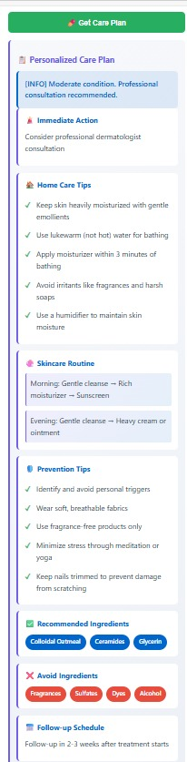
Module 3 Output

Slide 15
CONCLUSION
Smart system enables early and accurate detection of skin diseases
Uses AI and image processing to reduce manual diagnosis errors
Provides basic care, treatment, and prevention recommendations
Saves time and cost by reducing frequent hospital visits
Supports remote healthcare and improves skin health awareness

Slide 16
FUTURE SCOPE
Improve accuracy using advanced deep learning and larger datasets
Support detection of a wider range of skin diseases, including rare conditions
Integrate with mobile apps and cloud platforms for real-time analysis
Enable direct online consultation with dermatologists
Add multilingual support and personalized treatment recommendations

Slide 17
REFERENCES
ISIC Archive (2020–2024). International Skin Imaging Collaboration Dataset. Available online: https://www.isic-archive.com
Wu, X., Xu, Y., & Liu, J. (2020). Deep learning-based classification of inflammatory skin diseases using clinical images. IEEE Access.
Srinivasu, P. N., et al. (2021). Skin disease classification using MobileNet and deep learning techniques. Sensors.
Al-Masni, M., et al. (2022). Automated skin lesion segmentation and classification using deep CNN models. ISIC Dataset Studies.
Ahammed, S. S., et al. (2023). Machine learning approach for multiclass skin disease detection. Healthcare Analytics Journal.

Slide 18


